Slide 1
Adjustment Disorder: Adjustment disorder is a group of symptoms, such as stress, feeling sad or hopeless, and physical symptoms that can occur after you go through a stressful life event. The symptoms occur because you are having a hard time coping. Your reaction is stronger than expected for the type of event that occurred.

Slide 2


Adjustment disorder with depressed mood

Slide 3


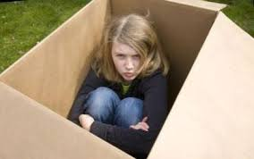
Adjustment disorder with anxiety

Slide 4


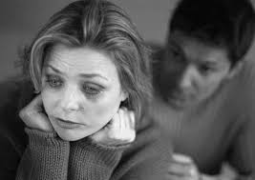
Adjustment disorder with mixed anxiety and depressed mood

Slide 5
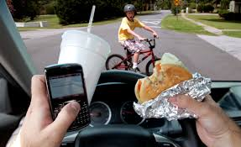

Adjustment disorder with disturbance of behaviour

Slide 6
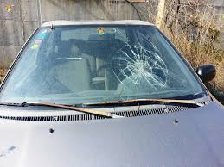


Adjustment disorder with disturbance of conduct

Slide 7

Adjustment disorder with mixed disturbance of emotions and behaviour

Slide 8

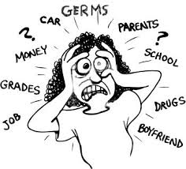
Adjustment disorder unspecified

Slide 9



COPING MECHANISMS

Slide 10
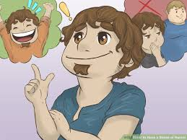


Slide 11
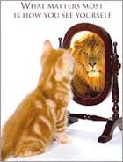



Slide 12




Slide 13
